Slide 1

ABC CALL VOLUME TREND
-HARISH

Slide 2

Project description
The project focuses on analyzing the call volume trends of ABC Insurance Company's inbound call center. Through analysis, we will extract valuable insights that can inform strategic decision-making within the advertising space, shedding light on the most effective channels for customer conversion.

Slide 3

Tech Stack used
Software: Microsoft Excel 2023
Easy to use
Quick in data manipulation
Visualization
Built-in functions

Slide 4

Approach
To achieve our objective , follow these steps:
Data collection and cleaning
Exploratory data analysis

Slide 5

Data collection and cleaning
Collected the dataset from the source and loaded it into the Excel
Duplicate values found and removed. (979 cells)

Slide 6
Exploratory Data Analysis(EDA)
Consider a few tasks as follows to find Trends, Patterns and insights from the data

Slide 7
1. Average Call Duration: Determine the average duration of all incoming calls received by agents. This should be calculated for each time bucket Task: What is the average duration of calls for each time bucket?
Explanation:
created pivot tables with rows: ‘time_bucket’ values: average of ‘call_seconds’ and filter: ‘call_status’. With the help of a filter considered only transfer and answered calls.
Created clustered column chat for the data obtained in the pivot table. We can view the average duration of calls for each time bucket as shown in the figure 1.
Insight: The highest average duration of incoming calls received by agents ‘10-11’and the lowest is at ’12-13’

Slide 8
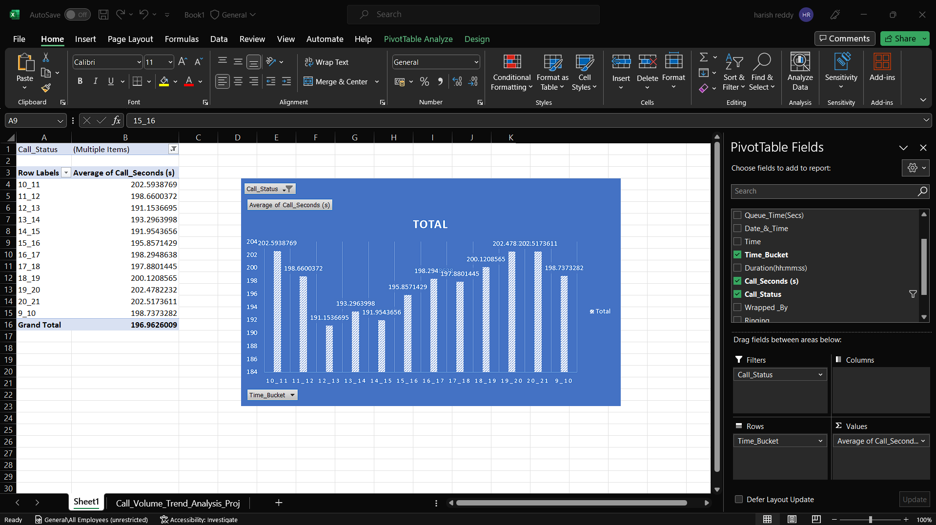
Figure 1

Slide 9
2. Call Volume Analysis: Visualize the total number of calls received. This should be represented as a graph or chart showing the number of calls against time. Time should be represented in buckets (e.g., 1-2, 2-3, etc.). Task: Can you create a chart or graph that shows the number of calls received in each time bucket?
Explanation:
created a pivot table with rows: ‘time_bucket’ values: count of ‘agent_id’.
The plotted bar chart using obtained data (time buckets vs number of calls received)as shown in figure 2.
Insight: The total number of calls is ‘117009’, the highest number of calls came in between ‘11-12’ and the lowest number of calls came in between ’20-21’.

Slide 10
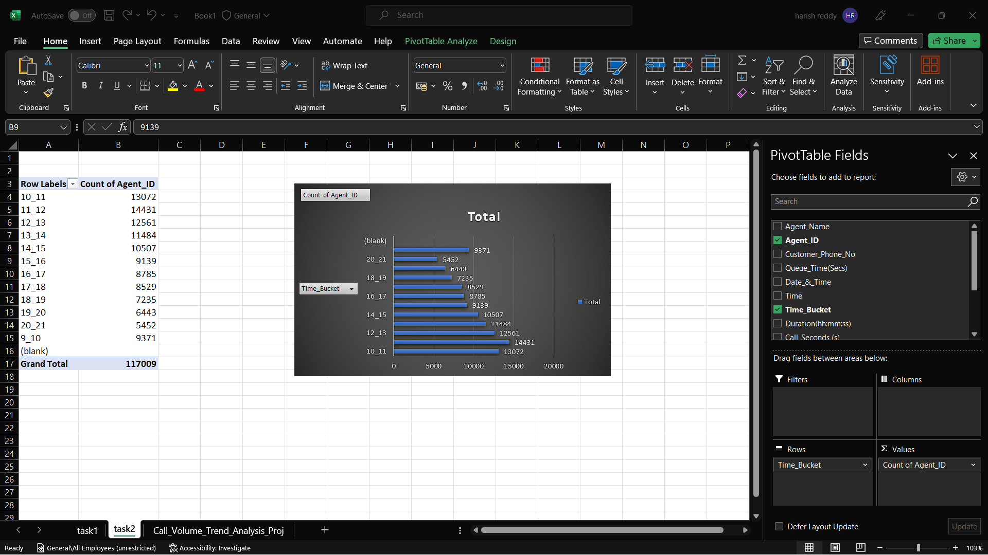
Figure 2

Slide 11

Assumptions:
An agent works for 6 days a week; On average, each agent takes 4 unplanned leaves per month
An agent's total working hours are 9 hours, out of which 1.5 hours are spent on lunch and snacks in the office.
On average, an agent spends 60% of their total actual working hours (i.e., 60% of 7.5 hours=4.5 HOURS) on calls with customers/users. The total number of days in a month is 30.

Slide 12
3. Manpower Planning: The current rate of abandoned calls is approximately 30%. Propose a plan for manpower allocation during each time bucket (from 9 am to 9 pm) to reduce the abandon rate to 10%. In other words, you need to calculate the minimum number of agents required in each time bucket to ensure that at least 90 out of 100 calls are answered. Task: What is the minimum number of agents required in each time bucket to reduce the abandon rate to 10%?
Explanation: To make calculations easily, calculated the number of agents per day with a 30% abandoned rate and later using a unitary method calculated the number of agents for 10%. With the help of time distribution, we calculated agents for each time bucket as shown in Figure 3
To calculate agents worked per day create a pivot table using ‘days(date and time)’, count of 'agent_id’, and sum of ‘call_seconds’
To calculate agents required for each time bucket created pivot table using columns ‘time_bucket’, ‘call_seconds’ and calculated time distribution as shown in figure 3
NOTE: For each time bucket we got required agents in decimal but if we round off the number of agents per day it increase so for understanding purpose, I mentioned a rounded column beside the required agent's column in Excel worksheet
Insight: The number of agents required for morning shifts (9 am-9 pm)is 63.

Slide 13
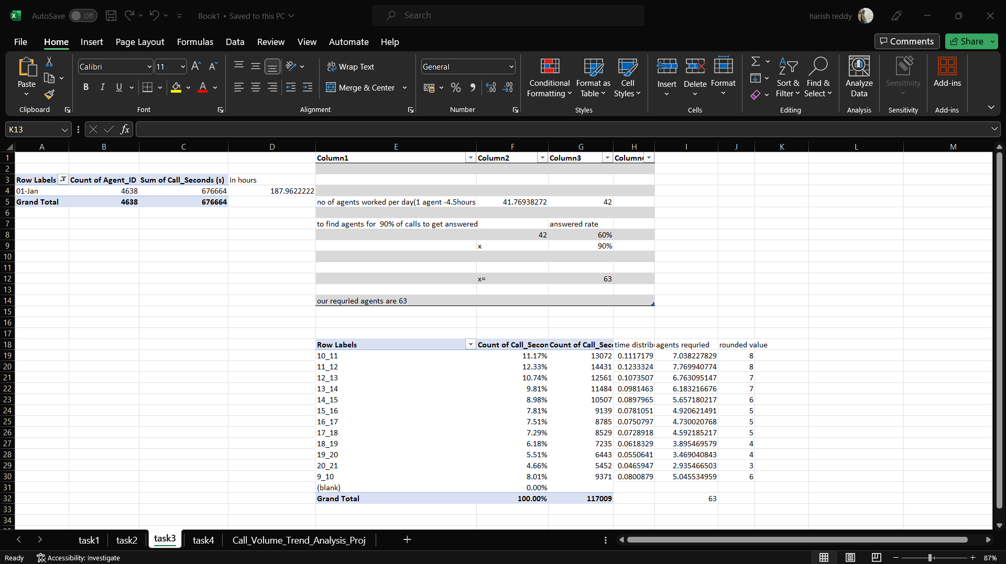
Figure 3

Slide 14
4. Night Shift Manpower Planning: Customers also call ABC Insurance Company at night but don't get an answer because there are no agents available. This creates a poor customer experience. Assume that for every 100 calls that customers make between 9 am and 9 pm, they also make 30 calls at night between 9 pm and 9 am. The distribution of these 30 calls is as follows: Task: Propose a manpower plan for each time bucket throughout the day, keeping the maximum abandon rate at 10%
Explanation:
Initially created a pivot table using time_bucket, call_status, and call_seconds columns.
Later, calculated the average incoming calls per day and by multiplying it by 0.3 we get the average incoming calls for the night shift.
followed by calculated additional hours required = (average incoming calls for night shift * 0.9 * average call duration in hours) by using it calculated agents required per night shift = additional hours /4.5hours
NOTE: For each time bucket we got required agents in decimal but if we round of the number of agents per day is getting increase so for understanding purpose, I mentioned a rounded column beside the required agent's column in excel worksheet
Insight: The number of agents required for night shifts (9 pm-9 am) is 23.

Slide 15
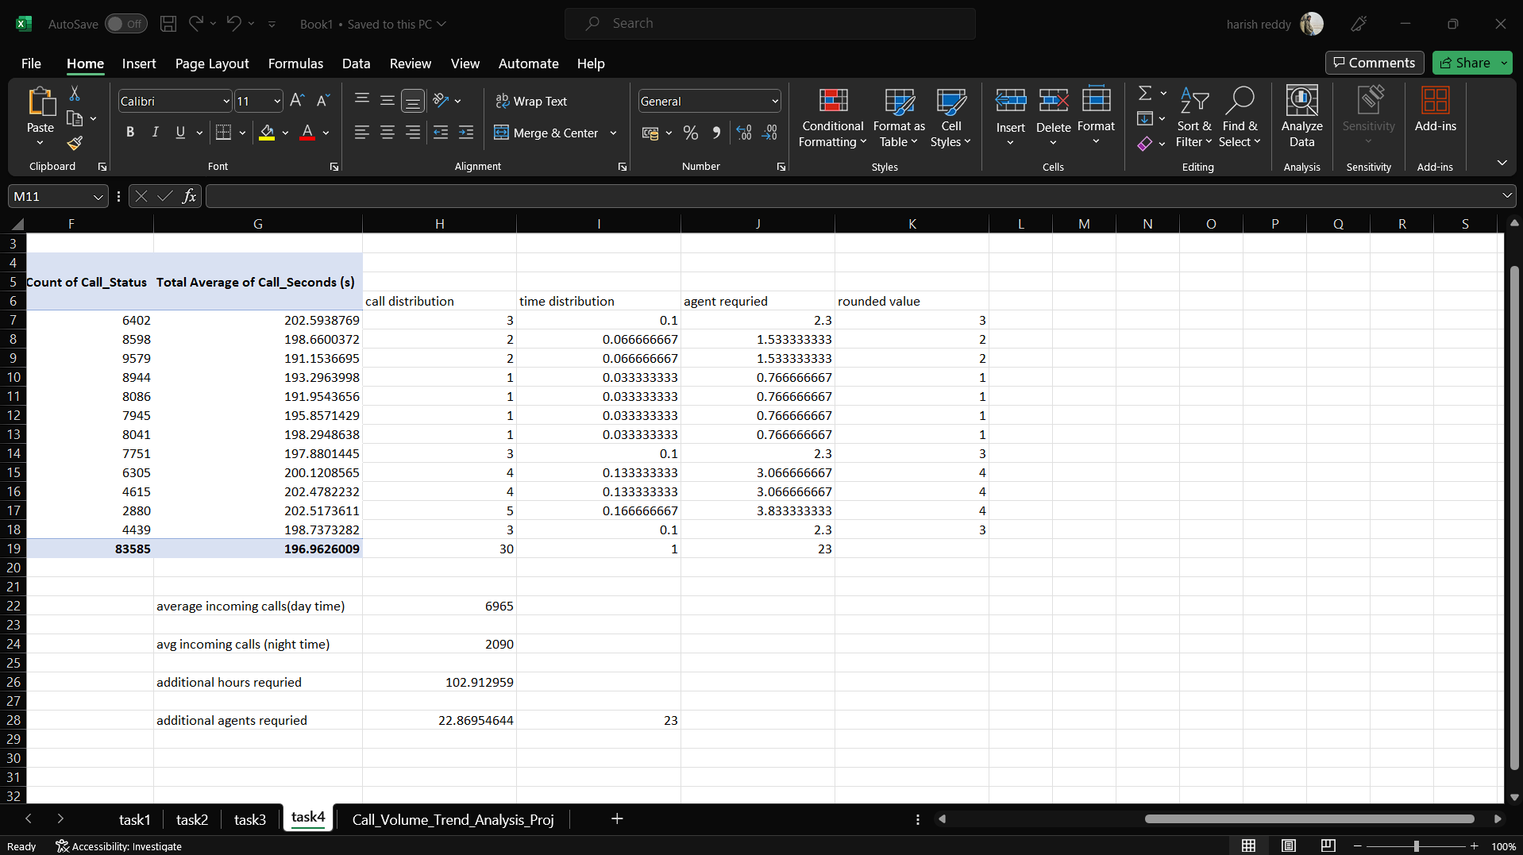
Figure 4

Slide 16
Insight’s summary:
The highest average duration of incoming calls received by agents ‘10-11’and lowest is at ’12-13’
The total number of calls is ‘117009’, the highest number of calls came in between ‘11-12’ and the lowest number of calls came in between ’20-21’.
The number of agents required for morning shifts (9 am-9 pm)is 63.
The number of agents required for night shifts (9 pm-9 am) is 23.

Slide 17

Result
These results from Tasks will serve as a foundation for data-driven decision-making, allowing the organization to refine its advertising strategies and enhance the overall customer experience, ultimately leading to improved customer acquisition and retention.

Slide 18

Reference
Dataset[Link to the data]
Excel book[Link to worksheet]

Slide 19

Thank you
Gmail ID: ananthulaharishreddy@gmail.com

